Slide 1

IOT AS WEATHER STATION
16BCE0029
SHRAVAN KORTHIWADA
16BCE0723
VISHAL SALVANKAR
16BCE0806
SHAILENDRA SHARMA
16BCE0926
GAURAV MALIK
16BCE0947
ABHINAV SHARMA
Under the Guidance of
Dr M Rajasekhara Babu
School of Computer Science and Engineering

Slide 2
Outline
Introduction
Importance of Application
Problem Statement
Objectives
Related Work
National Status
International Status
Design Model
Block Diagram’s
Algorithms
Flowcharts
Requirements
Hardware Components
Software’s
System Overview
Functional Components
GUI Design
Schematic Diagram
Invention Details
Objects of the Invention
Brief Description of the Drawings
Working Examples
Working Example 1
Working Example 2
Working Example 3
Implementation
Pseudo Code

Slide 3

Introduction
Introduction
What is IoT?
IoT stands for Internet Of Things.
It is dynamic global network infrastructure with self configuring capabilities based on standard and interoperable communication protocols.
All the physical and virtual “things” have identities in an IoT system.

Slide 4

Importance of application
Introduction
Importance/Need of App
Importance of Weather Station:
Our application has great importance since we can analyse the weather conditions and be aware of the current calamities.
IOT weather reporting system has application to farmers as well. It plays very important role in the field of agriculture.
It directly or indirectly influences the economy sector.
Need Of IoT:
Sensors are used which converts the physical parameter to electrical signals.
These sensors in integration with IoT help in collecting weather data which is further pooled in cloud for analysis.
Internet then can display the weather prediction based on the calculations of the inputs collected through sensors.

Slide 5

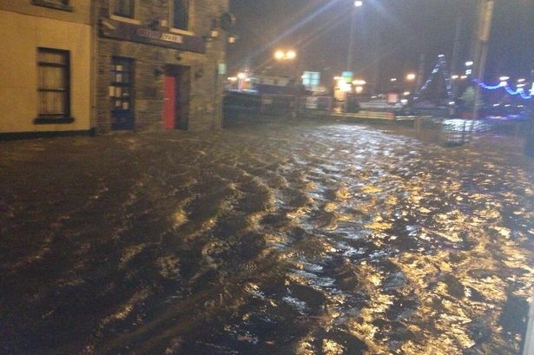
Problem Statement
Introduction
Importance/Need of App
Problem Statement
To develop an apparatus and method that could display the current weather conditions using various sensors and display it using Internet of Things (IoT) and sensors.

Slide 6

Objectives
Introduction
Importance/Need of App
Problem Statement
Objectives
To study various sensors and related technologies
To design methodology for weather station
To develop a low cost sensor based controllers for water conservation
To connect all the sensors through an arduino and collect the readings
To deploy a system for weather station and to display it

Slide 7
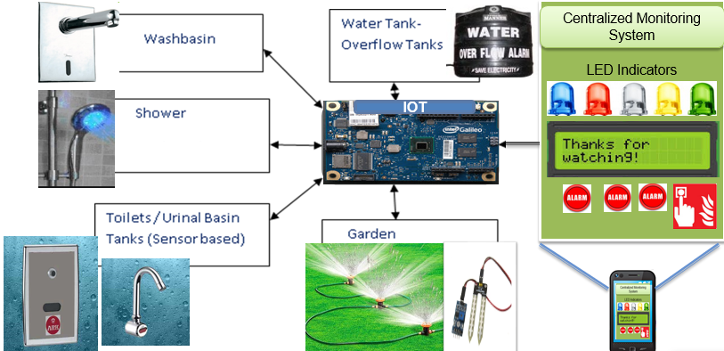
Model
Introduction
Importance/Need of App
Problem Statement
Objectives
Design Model

Slide 8
List of Hardware Components
Introduction
Importance/Need of App
Problem Statement
Objectives
Design Model
Requirements
Hardware
Arduino UNO
Temperature and Humidity Sensor(DHT11)
Barometric Pressure/Temperature/Altitude Sensor(BMP085)
LDR(Light Dependent Resistor)
Raindrop sensor
Ethernet Shield
Breadboard

Slide 9
Description of Hardware Components
Introduction
Importance/Need of App
Problem Statement
Objectives
Design Model
Requirements
Hardware
Arduino
Model: Arduino UNO
Vendor: Module 143
Price: Rs. 480
Spec: Microcontroller Atmega328
Clock Speed 16MHz Voltage 5V
Description:
Arduino is an open source computer hardware and software company, project, and user community that designs and manufactures single-board microcontrollers and microcontroller kits for building digital devices and interactive objects that can sense and control objects in the physical and digital world. It is the heart of the device. It provides the platform for IOT. It is used to connect to various sensors and collect the data from sensors and display it on website :
Reference URL: https://www.arduino.cc/

Slide 10
Description of Hardware Components
Introduction
Importance/Need of App
Problem Statement
Objectives
Design Model
Requirements
Hardware
DHT
Model: DHT11
Vendor: Module 143
Price: Rs. 160
Spec: Sensing Element: Polymer resistor Vdd: 3.5 to 5.5V DC
Description:
The DHT11 sensor includes a resistive-type humidity measurement component, an NTC temperature measurement component and a high-performance 8-bit microcontroller inside, and provides calibrated digital signal output.
Reference URL:
https://image.dfrobot.com/image/data/KIT0003/DHT11%20datasheet.p

Slide 11
Description of Hardware Components
Introduction
Importance/Need of App
Problem Statement
Objectives
Design Model
Requirements
Hardware
LDR
Model: LDR
Vendor: Module 143
Price: Rs. 10
Spec: Voltage: 320V max Current: 75mA max Power dissp: 100mW
Description:
An LDR is a variable resistor controlled by light. The increasing light intensity falling on it decreases the resistance of the LDR. We can calculate the light index using the resistance parameter.
Reference URL:
https://www.kitronik.co.uk/blog/how-an-ldr-light-dependent-resistor-works/

Slide 12
Description of Hardware Components
Introduction
Importance/Need of App
Problem Statement
Objectives
Design Model
Requirements
Hardware
Rain Sensor
Model: Raindrop Sensor
Vendor: Module 143
Price: Rs. 155
Spec: Voltage: 5V Area: 5cm X 4cm nickel plate on side
Description:
It is used for the detection of rain. It can also be used for measuring the intensity of the rain. It has both digital output as well as analog output. This module measures the moisture through analog output pin and when the threshold of moisture exceeds too much it provides a digital output. The more water or the lower resistance means lower output voltage. Where as, the less water means higher resistance, i.e , high output voltage on the analog pin. For example a completely dry board will cause the module to output ﬁve volts.
Reference URL:
https://www.openhacks.com/uploadsproductos/rain_sensor_module.pdf

Slide 13
Description of Hardware Components
Introduction
Importance/Need of App
Problem Statement
Objectives
Design Model
Requirements
Hardware
Ethernet Shield
Model: HR911105A
Vendor: Module 143
Price: Rs. 155
Spec: Voltage: 5V Connection speed: 10/100Mb
Description:
The Arduino Ethernet shield 2 allows an Arduino board to connect to the internet using the Ethernet library and to read and write an SD card using the SD library. The shield is fully compatible with the former version, but relies on the newer W5500 chip.
Reference URL:
https://www.openhacks.com/uploadsproductos/rain_sensor_module.pdf

Slide 14
List of Software's
Introduction
Importance/Need of App
Problem Statement
Objectives
Design Model
Requirements
Hardware
Software
Arduino IDE
Version: 1.6.9
Description: To run the arduino UNO and collect all the readings of sensors
Reference: https://www.arduino.cc/
Python
Version: 2.7
Description: To send the URL to ThingSpeak
Reference: https://www.python.org/downloads/
ThingSpeak
Description: Acts as a cloud server and displays it in a form of a graph
Reference: https://thingspeak.com/

Slide 15
Functional Modules
Introduction
Importance/Need of App
Problem Statement
Objectives
Design Model
Requirements
Hardware
Software
System Overview
Design Considerations/ Architecture Strategies/ System Architecture
Detailed System Design
Functional Modules
1. Sensing module : DHT11, Rain Module, LDR
2. Process module : Arduino, Ethernet Sheild
3. Gateway interface module : Arduino and Ethernet Cable
4. Cloud module : ThingSpeak and Ethernet server
5. GUI module : Laptop Screen
…

Slide 16
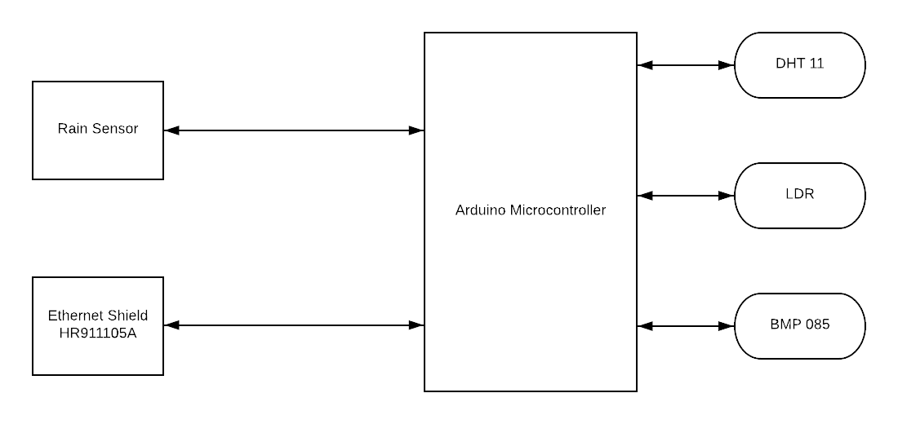
Schematic Diagram

Slide 17
Invention Details
Introduction
Importance/Need of App
Problem Statement
Objectives
Design Model
Requirements
Hardware, Software
System Overview
Design Considerations Detailed System Design, GUI Design
Invention Details
Objectives of the Invention
Brief Description of the Drawings
Working Examples
Working Example 1
Working Example 2
Working Example 3
Objects of the invention: Arduino IDE, Ethernet Shield, Rain Module, DHT module, LDR
Summary of the invention: We have succesfully designed and developed the model for IoT as weather station.

Slide 18
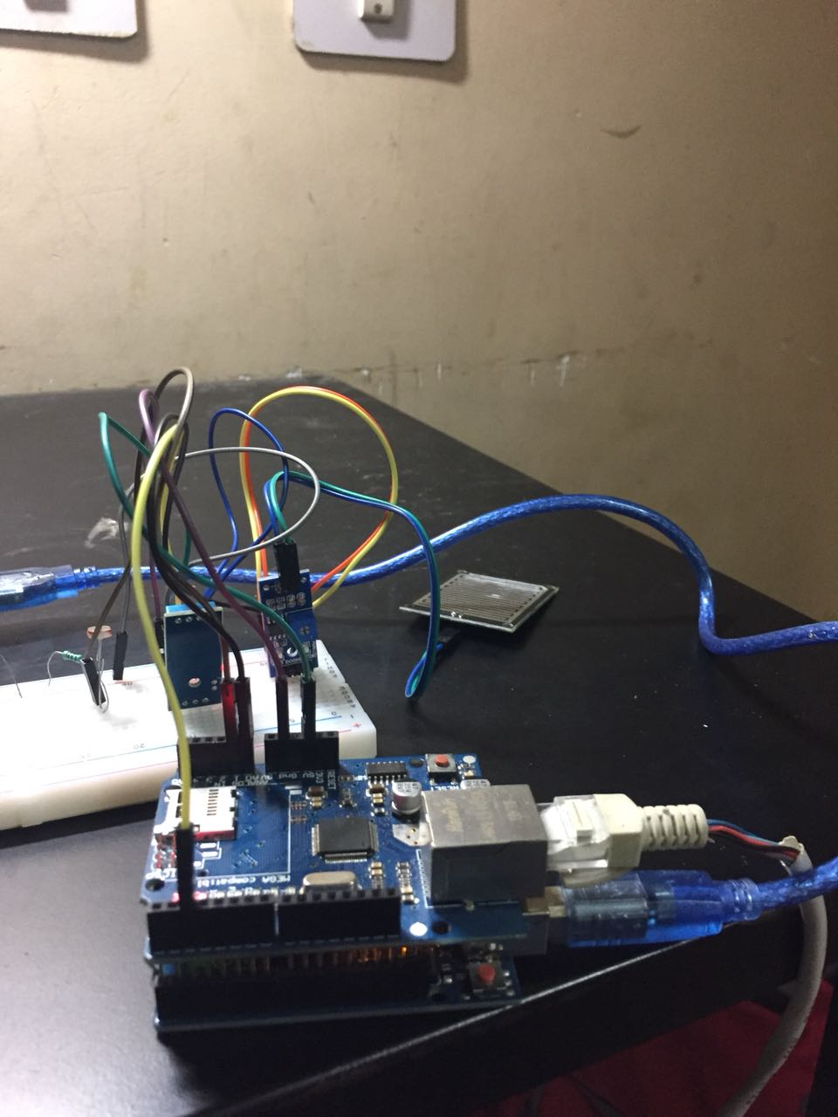
Working Example 1
System Overview
Design Considerations/ Architecture Strategies/ System Architecture
Detailed System Design, GUI Design
Invention Details
Objects of the Invention
Brief Description of the Drawings
Working Examples
Working Example 1

Slide 19
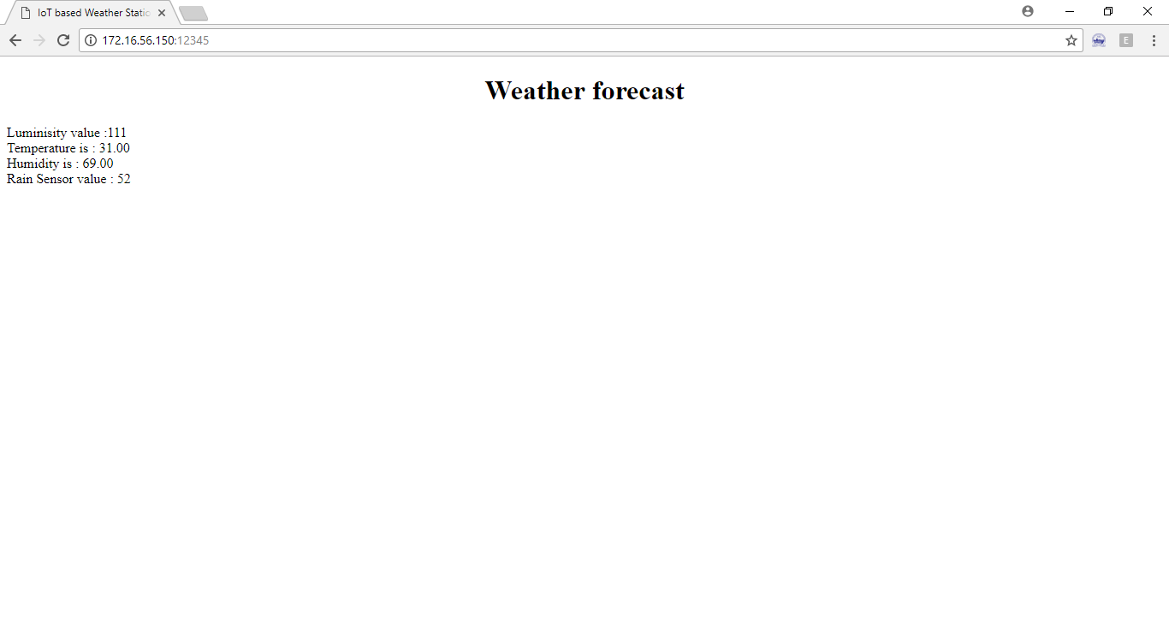
Working Example 2
System Overview
Design Considerations/ Architecture Strategies/ System Architecture
Detailed System Design, GUI Design
Invention Details
Objects of the Invention
Brief Description of the Drawings
Working Examples
Working Example 1
Working Example 2

Slide 20
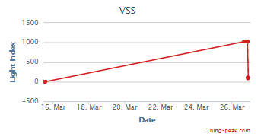
Working Example 3
System Overview
Design Considerations/ Architecture Strategies/ System Architecture
Detailed System Design, GUI Design
Invention Details
Objects of the Invention
Brief Description of the Drawings
Working Examples
Working Example 1
Working Example 2
Working Example 3

Slide 21
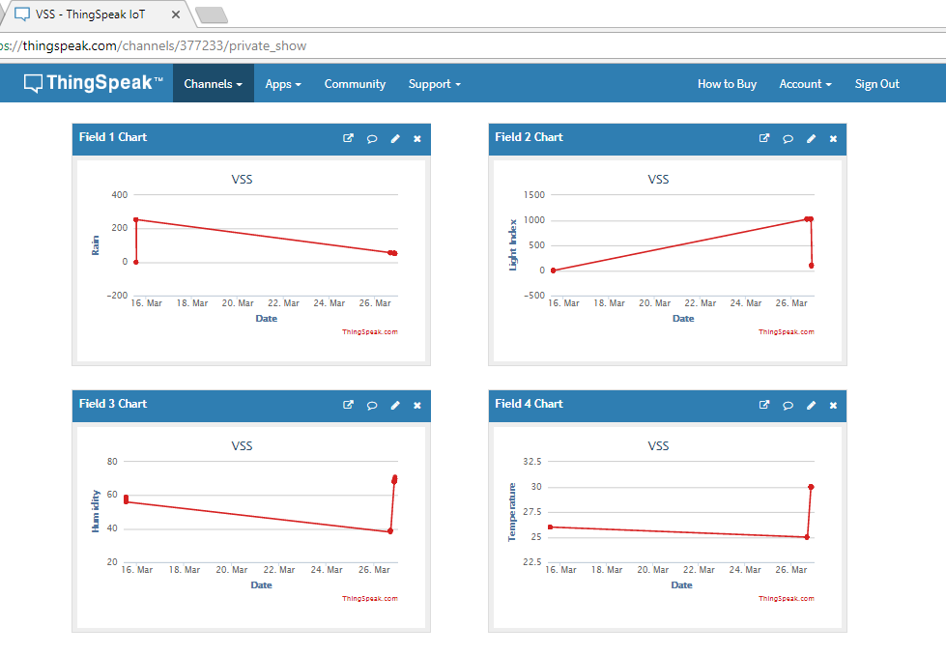
Working Example 4
System Overview
Design Considerations/ Architecture Strategies/ System Architecture
Detailed System Design, GUI Design
Invention Details
Objects of the Invention
Brief Description of the Drawings
Working Examples
Working Eg. 1
Working Eg. 2
Working Eg. 3
Working Eg. 4

Slide 22
Demo Video You Tube link
System Overview
Design Considerations/ Architecture Strategies/ System Architecture
Detailed System Design, GUI Design
Invention Details
Objects of the Invention
Brief Description of the Drawings
Working Examples
Working Eg. 1
Working Eg. 2
Working Eg. 3
Working Eg. 4
Demo Video
https://youtu.be/M7SwZKHBDf0

Slide 23

Conclusion
Introduction
Importance/Need of App
Problem Statement
Objectives
Design Model
Requirements
Hardware
Software
Conclusion
Develop an apparatus and method for displaying weather conditions and various parameters of natural conditions in VIT

Slide 24
References
Bruce Hartley, Lead Systems Engineer ,"The Internet of Things - Weather Monitoring too", 2008.
Bulipe Srinivas Rao, Prof. Dr. K. Srinivasa Rao, Mr. N. Ome, "Internet of Things (IOT) Based Weather Monitoring system", International Journal of Advanced Research in Computer and Communication Engineering,September 2016
Kondamudi Siva Sai Ram1 , A.N.P.S.Gupta2, "IoT based Data Logger System for weather monitoring using Wireless sensor networks ",International Journal of Engineering Trends and Technology (IJETT), February 2016
C. Pfister, Getting Started with the Internet of Things. Sebastopol, CA: O'Reilly Media Inc., 2011.
Aarti Rao Jaladi, Karishma Khithani, Pankaja Pawar, Kiran Malvi, Gauri Sahoo, " Environmental Monitoring Using Wireless Sensor Networks(WSN) based on IOT " ,International Research Journal of Engineering and Technology,January 2017
[online] Available:http://iotworm.com/internet-of-things-technology-weather-forecasting/

Slide 25


